Slide 1
Section 0.3
“Before Calculus”: Families of Functions

Slide 2
All graphics are attributed to:
Calculus,10/E by Howard Anton, Irl Bivens, and Stephen Davis Copyright © 2009 by John Wiley & Sons, Inc. All rights reserved.

Slide 3
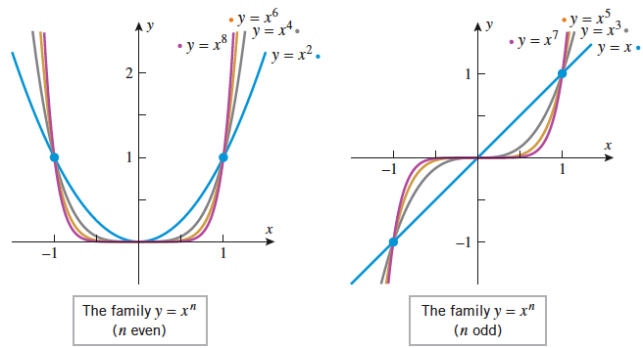
Examples of Families
There are two examples of families of lines on page 27 and more difficult families on pgs 29-31.
In example 0.3.2 (a) on pg 27, the linear equations for the graphs all have the same y-int. and different slopes.
In example 0.3.2 (b), they all have the same slope and different y-intercepts.
Below, they all have even exponents on the left and odd exponents on the right.

Slide 4
Rational functions
A function that can be expressed as a ratio of two polynomials is called a rational function.
You may or may not remember the rules for vertical and horizontal asymptotes and holes.
Where the denominator of your rational function equals zero, there is either a hole or a vertical asymptote.
If the factor giving you a certain result cancels when simplifying, then you have a hole in the graph at that value of x.
If the factor does not cancel, then there is a vertical asymptote at that value of x. (con’t)

Slide 5
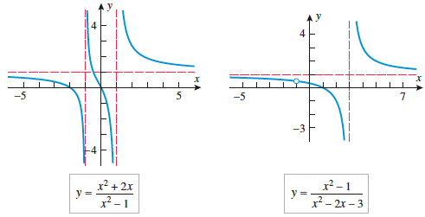
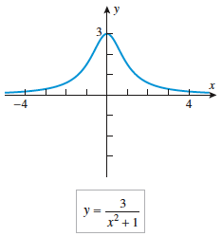
Horizontal asymptote rules (I have a handout of these rules if you do not have one from last year):
When the degree of the numerator < the degree of the denominator, there is a horizontal asymptote at y=0.
When the degree of the numerator = the degree of the denominator, there is a horizontal asymptote at y = the ratio of the leading coefficients of the numerator and denominator.
When the degree of the numerator > the degree of the denominator, there is no horizontal asymptote.

Slide 6
The Families y = Asin(Bx – C) and y = Acos(Bx – C)
You are probably more accustomed to seeing them in these forms:
y = asinb(x-h)+k and y = acosb(x-h)+k
It is OK to continue using those forms, just be aware that this book does not factor out the B. To make the horizontal shift (h) accurate, you must first factor.
Look at figure 0.3.13 on pg 33 for a few examples.

Slide 7
Amplitude, period, and frequency
A = a = amplitude, which is half of the vertical distance between the highest (maximum) and lowest (minimum) points.
(2Π)/B = (2Π)/b = period, which is the horizontal length of one cycle in your sine or cosine curve.
Frequency is the reciprocal of the period and it tells you how frequently a graph repeats the same values.

Slide 8
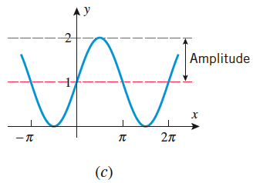
Sine and Cosine Example
We can write either a sine or cosine equation for this curve. They will share the same amplitude (a=1), period(2Π, so b=1), and vertical shift (up 1=k).
y=1sin1(x) + 1=sinx +1
or y =1cos1(x-(Π/2))+1
Cosine has a different horizontal shift which is determined by the maximum point (or by the minimum point if a is negative.

